Slide 1

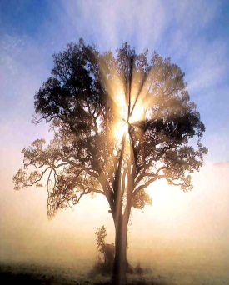
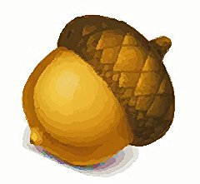
TCC CS 142B Fall 2012
Final Project - Group 4
Team Acorn
Master Programmer: Samuel Hubb
GUI Developer and Programmer: Jacob Casperson
Assistant to the Assistant and Report Writer: Dan Massie

Slide 2
TCC CS 142B Fall 2012
Final Project - Group 4
Team Acorn
Why Team Acorn?

Slide 3

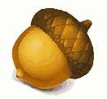
TCC CS 142B Fall 2012
Final Project - Group 4
In 1991, a group of Sun Microsystems engineers led by James Gosling decided to
develop a language for consumer devices (cable boxes, etc.). The project was
code-named Green. They first called their program “Oak”. Yes – This is now JAVA.
-That’s why you nut!

Slide 4
TCC CS 142B Fall 2012
Final Project - Group 4
Proposal: Create a game of pong
Make it larger than life with multiple
players and all the bells and whistles!

Slide 5
TCC CS 142B Fall 2012
Team Project - Group 4
Considerations/Difficulties:
Number of players
Collision detection
Third party libraries
Finding time to collaborate
Different levels of competence

Slide 6
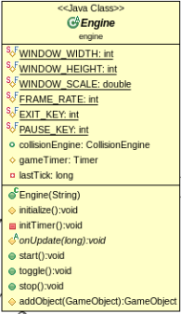
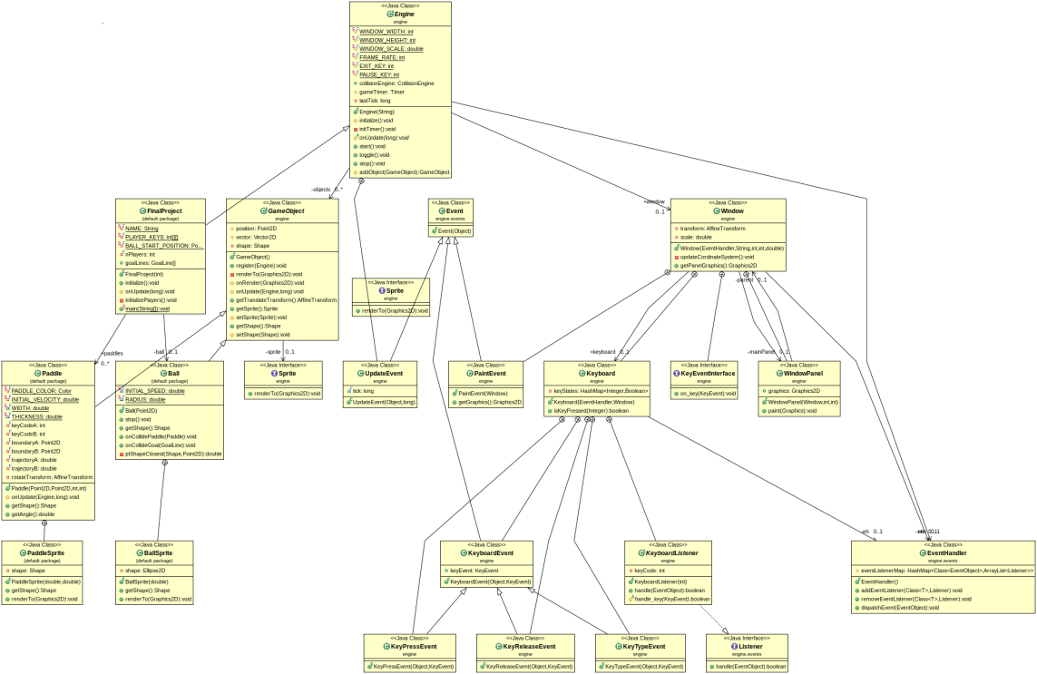
TCC CS 142B Fall 2012
Team Project - Group 4
UML DIAGRAM

Slide 7
TCC CS 142B Fall 2012
Team Project - Group 4
Success and Achievements:
Team-work and collaborative sharing
Just wait to you see the demonstration

Slide 8
TCC CS 142B Fall 2012
UML Diagram
Team Project - Group 4
Lessons Learned:
Start earlier
Work as a group to define classes and methods

Slide 9
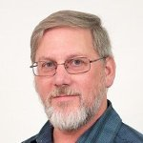
TCC CS 142B Fall 2012
The greatest oak was once a little nut who held its ground....… -Author Unknown.
Special thanks to:
Professor Meerdink
-Team Acorn

